Slide 1
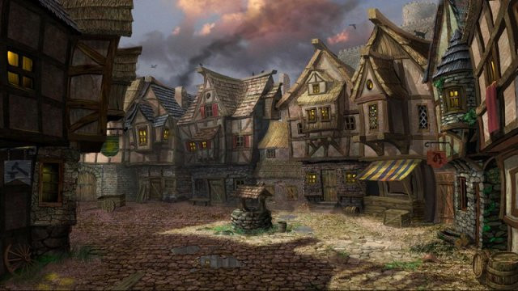
Notes:
1 - Town Square
2 - The Moon Market
3 - The Thoughtful Baker Bar
4 - The Flowing Hammer
5 - Day Dream Library

Slide 2
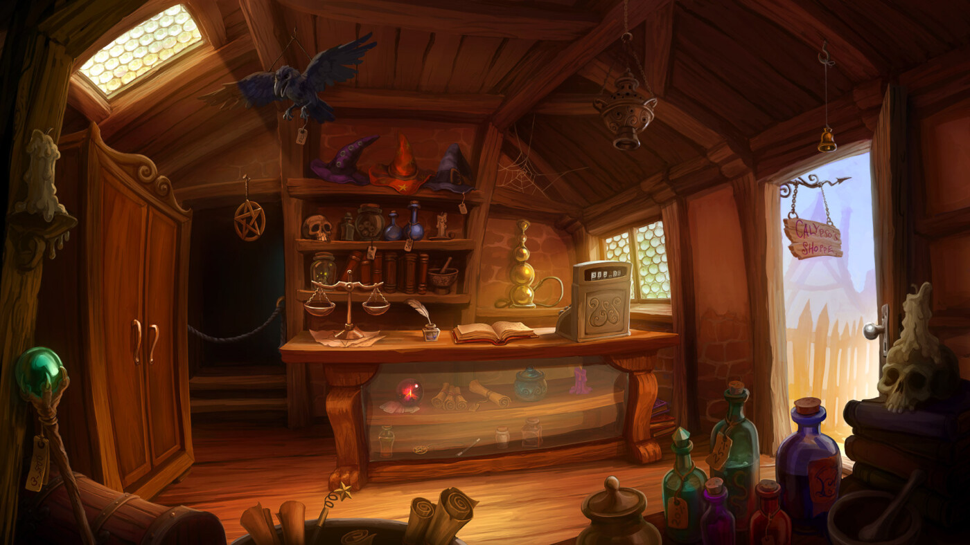
Notes:
1 - Town Square
2 - The Moon Market
3 - The Thoughtful Baker Bar
4 - The Flowing Hammer
5 - Day Dream Library

Slide 3
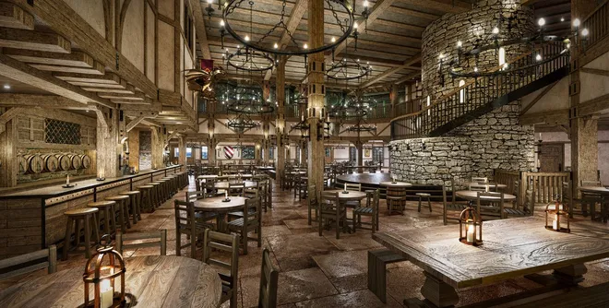
Notes:
1 - Town Square
2 - The Moon Market
3 - The Thoughtful Baker Bar
4 - The Flowing Hammer
5 - Day Dream Library

Slide 4

Notes:
1 - Town Square
2 - The Moon Market
3 - The Thoughtful Baker Bar
4 - The Flowing Hammer
5 - Day Dream Library

Slide 5
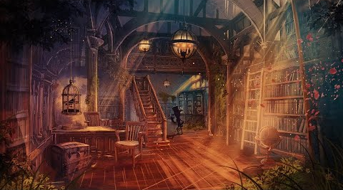
Notes:
1 - Town Square
2 - The Moon Market
3 - The Thoughtful Baker Bar
4 - The Flowing Hammer
5 - Day Dream Library

